Slide 1

Machine Learning Project
Nino Orton-Clarke

Slide 2
Steps Taken
Data Importing
Data Cleansing
Visualization
Label Encoding
Normalisation
Undersampling
Classification Models
Regression Models
Evaluation of Models
Conclusion

Slide 3
Data Importing & EDA
Once each dataset was imported exploratory data analysis (EDA) could begin.
EDA includes functions like .head(), .info() to further understand aspects of the data e.g., no. of columns/rows, no. of null values or the data types in each column.
The same functions were carried out on both datasets.
The EDA process allows us to plan/decide what processes need to be carried out before the data before it can be implemented into models.

Slide 4
Data Cleansing
Only the airplane crashes dataset required data cleansing, consisting of multiple processes as there were various issues with the data.
Columns with thousands of nulls were dropped – e.g., ‘Flight #’ had 4199 null values.
‘Date’ column was split into ‘Year’, ‘Month’, ‘Day’.
Remaining nulls were dropped using dropna(inplace = True).

Slide 5
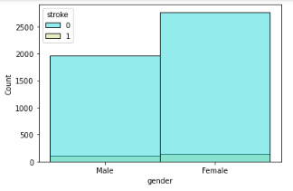
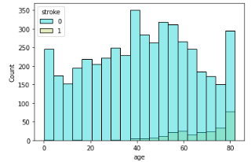
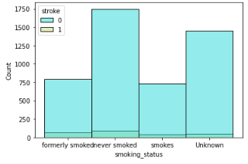
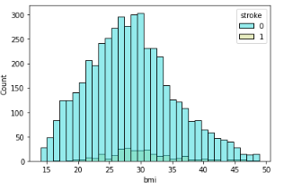
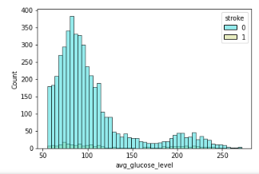
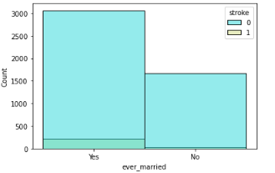
Visualizations Sample
Brain Stroke Data
Fig 1: Histplot of Stroke/Gender
Fig 2: Histplot of Stroke/Age
Fig 3: Histplot of Stroke/Smoking Status
Fig 4: Histplot of Stroke/BMI
Fig 5: Histplot of Stroke/Marital Status
Fig 6: Histplot of Stroke/Av Glucose Level

Slide 6
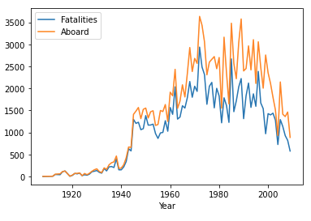
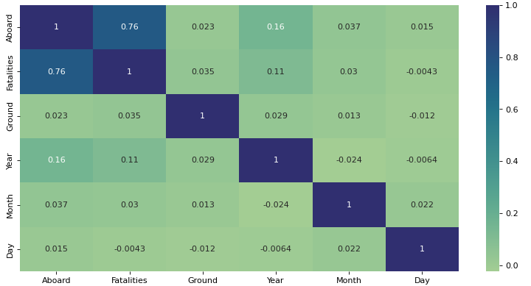
Visualizations Sample
Airplane Crash Data
Fig 7: Line Graph of Fatalities & Aboard/Year.
Fig 8: Heatmap of correlation between variables.

Slide 7
Label/One Hot Encoding
Label/one hot encoding was used on both datasets - categorical data could be transformed into numerical data so the dataset could be normalized.
Brain Stroke Dataset – ‘Gender’, ‘Ever married’, ‘Work type’, ‘Residence Type’ and ‘Smoking type’ were all encoded.
Airplane Crash Dataset – Only ‘Date’, ‘Location’ and ‘Operator’ were encoded.

Slide 8
Normalisation & Undersampling
Both datasets were normalised using the MinMaxScaler(), converting all values within the respective dataset to a value between 0 and 1.
For the brain stroke data only undersampling was required due to the disparity in class distribution within the dataset.
This improves the prediction/evaluation accuracy of models.

Slide 9
Classification Models
Before creating an instance of any model, the data must be split into X and y variables.
‘y’ variable being the target variable.
Data is then trained using train test split.
Models are then fitted to the train data in order to produce predictions within a classification report and confusion matrix.

Slide 10
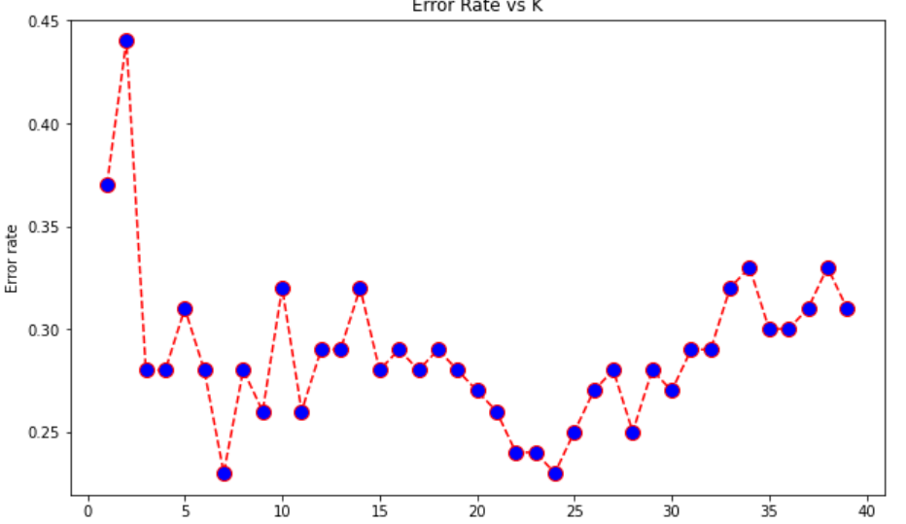
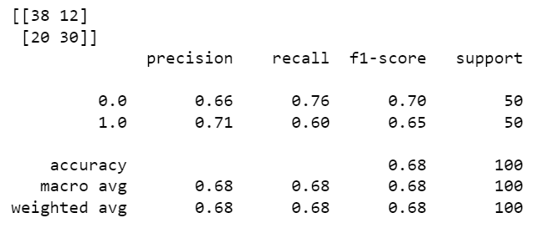
Classification Model 1 – KNN Results
KNN model produced the classification report and confusion matrix seen in fig 9.
Looking at the confusion matrix we can see there is a total of 32 false predictions and 69 true predictions.
Scores ranged between 0.65 and 0.76, with the majority being the mid to late 60s.
The K- value used for this model was 10, however the optimal K-value displayed by fig 10 is 7.
Fig 9: KNN classification report and confusion matrix
Fig 10: KNN error rate vs K graph

Slide 11
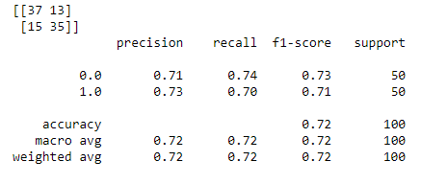
Classification Model 2 – Dtree Results
As we can see in fig 11 the confusion matrix shows a total of 28 false predictions and 72 true predictions.
Prediction scores ranged between 0.71 and 0.74, suggesting that predictions made by the model are more than 70% accurate.
Fig 11: Dtree classification report and confusion matrix.

Slide 12
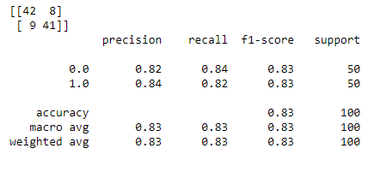
Classification Model 3 – Random Forest
Fig 12 shows only 17 false predictions in total and 83 true predictions.
Scores ranged between 0.82 and 0.84.
Predictions for this model are most likely more than 80% accurate.
Fig 12: Random Forest classification report and confusion matrix.

Slide 13
Classification Model Evaluation
We can compare the confusion matrices and classification reports of the 3 models tested to rank them in terms of accuracy of prediction by focusing on the F1 score and accuracy.
The best F1 accuracy score/accuracy score produced was by the random tree model (0.83) – we can say this was the best performing model.
KNN was the worst performing model, with and F1/accuracy score of 0.72.
Fig 9: KNN classification report and confusion matrix.
Fig 11: Dtree classification report and confusion matrix.
Fig 12: Random Forest classification report and confusion matrix.

Slide 14
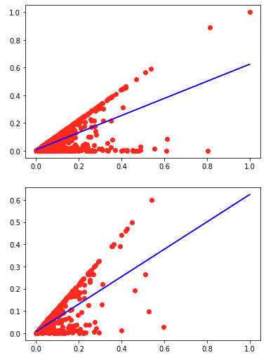
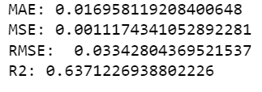
Regression Model 1 - SLR
When comparing the trained data with the test data in fig 13 and fig 14 we can see that there are some similarities in patterns of the two scatter plots.
Regression line is steeper in the test scatter, suggesting a greater rate of change.
R2 (R-squared) value is 0.64, shows how well the data fit the regression model from 0-1.
Low mean squared error score which suggests the regression line is not far from data points. (0.001)
Fig 13: SLR X_train/y_train scatter
Fig 14: SLR X_test/y_test scatter
Fig 15: SLR prediction scores

Slide 15
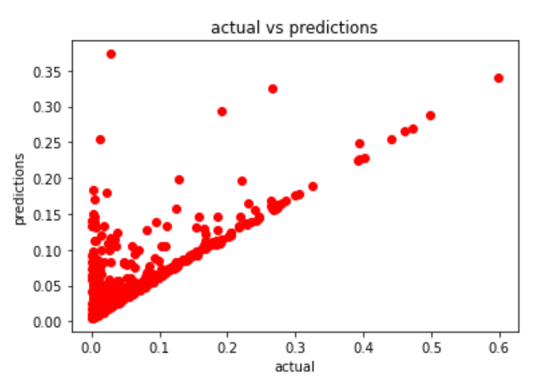
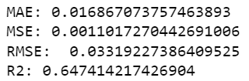
Regression Model 2 - MLR
Fig 16 shows us how the effects of the MLR model compares against the actual/null model.
R2 (R-squared) value is 0.65, not optimal but suggests the data fit the model reasonably well.
Low mean squared error score which suggests the regression line is not far from data points. (0.001)
Fig 16: MLR scatter of actual/predictions
Fig 17: MLR prediction scores

Slide 16
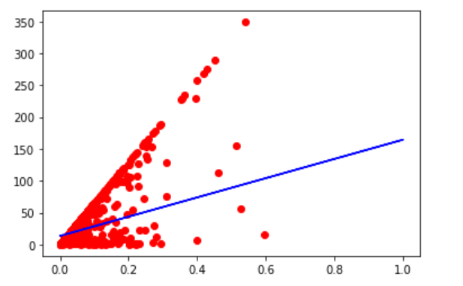
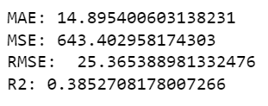
Regression Model 3 - Lasso
As we can see from fig 18 the lasso regression is depicted.
R2 score is equal to 0.39 which isn’t optimal, also the mean square error is 643 meaning the regression line is far from the data points.
Fig 18: Lasso scatter X_test/ y_test
Fig 19: Lasso prediction scores

Slide 17
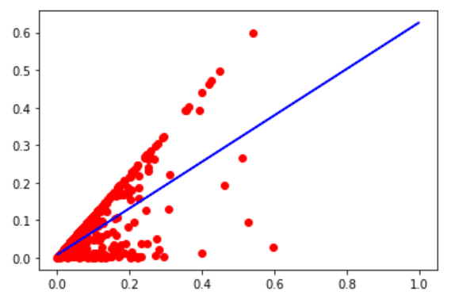
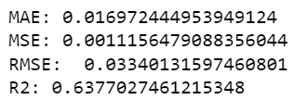
Regression Model 4 - Ridge
The ridge regression model produced an R2 value of 0.64 displayed in fig 21.
Low mean squared error score which suggests the regression line is not far from data points. (0.001)
Fig 20: Ridge scatter X_test/ y_test
Fig 21: Ridge prediction scores

Slide 18
Regression Model Evaluation
When evaluating regression models by prediction scores the two most important values are RMSE (root mean squared error) and R2 (R-squared).
As we can see from the figures below, the model with both the lowest RMSE and highest R2 value was the MLR model – therefore this was the best performing model
The worst performing model was Lasso as it produced the lowest RMSE and highest R2 values by a significant margin.
Fig 15: SLR prediction scores
Fig 17: MLR prediction scores
Fig 19: Lasso prediction scores
Fig 21: Ridge prediction scores

Slide 19
Conclusion
For the respective datasets used we can confidently define the best performing models of classification and regression.
Regression – MLR model was the best performing regression model, Lasso was the worst performing according to R2 and RMSE values.
Classification – the random forest model performed the best by providing the highest number of accurate predictions, whilst KNN was the worst.

